Slide 1
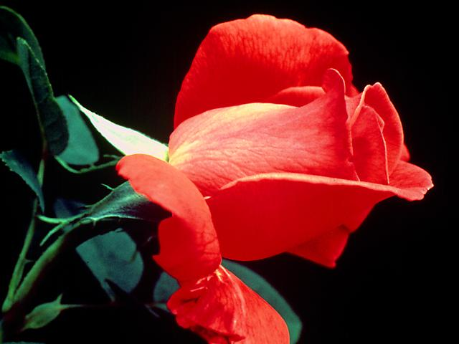
THE GOSPEL PRESENTATION
THE GOSPEL PRESENTATION

Slide 2
If Jesus were to come today would you be Saved?
If on your way to heaven God met you
at the gate and asked: “Why should I
let you into heaven?” What would you
answer?
The Bible says we must be sure of
our salvation. Listen to the Bible:

Slide 3
These things have I written unto you that believe on the name of the Son of God; that ye may know that ye have eternal life… 1John 5:13

Slide 4

John 10:27, 28. My followers hear my voice, and I know them, and they follow me: And I give unto them eternal life; and they shall never perish, neither shall any man pluck them out of my hand.
Allow me to share with you…

Slide 5
THE GOSPEL PRESENTATION
THE GOSPEL PRESENTATION

Slide 6

The Bible says that God is love:
He that loves not knows not
God; for God is love. 1John 4:8
And we have known and believed the love that God has for us. God is love… 1John 4:16

Slide 7

In order for God to be a God of love He has to demonstrate three main Characteristics:
Perfection
Mercy
Justice

Slide 8

The Bible says that God has all three
of these characteristics:
Perfection: Be ye therefore perfect,
even as your Father which is in
heaven is perfect. Mat. 5:48

Slide 9
Mercy: Ps. 86:15. But thou, O
Lord, art a God full of compassion and
gracious, longsuffering, and plenteous
in mercy and truth.
Psa 136:2,3 O give thanks unto the
God of gods: for his mercy endures for
ever. O give thanks to the Lord of
lords: for his mercy endures for ever.

Slide 10
Justice: He is the Rock, his work is
perfect: for all his ways are judgment:
a God of truth and without iniquity,
just and right is he. Deut. 32:4
And there is no God else beside me;
a just God and a Saviour… Isa. 45:12
We see then, that God is a loving God who is Perfect, Merciful, and a God of Justice…
Here’s a question?

Slide 11
Under what circumstances can this loving God Demonstrate mercy and justice?
Is it not in the area of sin and rebellion
against Him?
What really are sin and rebellion then?
Here is what the Bible says about sin:

Slide 12
Whosoever commits sin transgresses
also the law: for sin is the transgression
of the law. 1John 3:4
The word transgression means lawlessness or rebellion.
So sin is actually rebellion against God and
his law… And God is the source of all life…
What does God say are the consequences of sinning or rebellion against Him and His law?

Slide 13
For the wages of sin is death...
Rom. 6:23
Wherefore, as by one man sin entered
into the world, and death by sin; and so death passed upon all men, for that all have sinned… Rom. 5:12

Slide 14

We see, then, that humans have sinned, rebelled, against God’s law; and consequently they are deserving of death, for rebellion against God, the life-giver, can only bring death. Sin, then, is a transaction which if a man does, irrevocably leads to death;

Slide 15
and God does not stop us from sinning if we choose to do so, because that would be robbing humans of their freedom of choice and of the consequences that follow these choices.
But why must sin bring death?

Slide 16
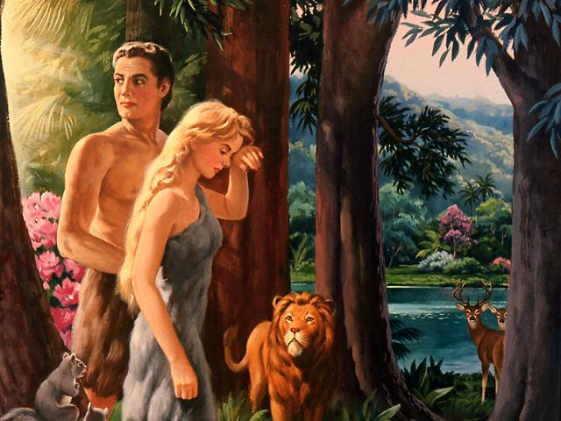
Why should Sin bring death?

Slide 17
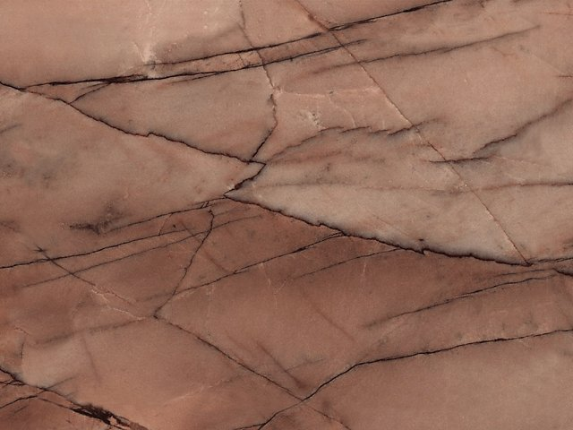
Sin is like AIDS, once you acquire it you must come down with the disease and eventually die…
Sin reprogrammes our system and separates us from God the source of all life; this leads to death…And we have all sinned against Him…
In the face of this rebellion against Him and His law, how can God show mercy and justice?

Slide 18

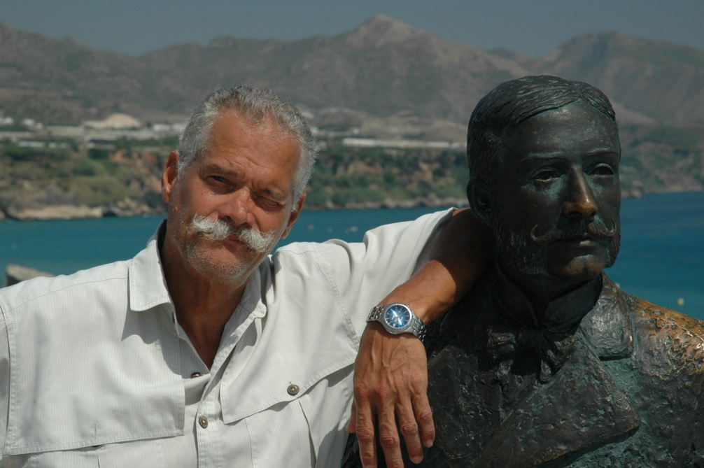

story
Listen to this story…
The twin brothers

Slide 19
story
There were two brothers that so resembled each other that the ordinary eye could not tell the difference. These brothers were very close; nothing could separate them. One was married the other was not.

Slide 20
story
In a fit of anger the married brother committed a horrendous crime; he killed a man with whom he quarrelled. The penalty in that country for murder was death; he was subsequently arrested, charged,

Slide 21
story
and sentenced to die. He had a beautiful wife and two little children whom he loved dearly; his sobs were uncontrollable. On the night before his execution his brother paid him a visit; the boys talked long into the

Slide 22
story
night; there were tears and hugs and a final farewell. Next morning the executioner walked the young man out and executed him, while the married brother went home to his wife and children…

Slide 23
Mercy
This, friends, is exactly how God demonstrated his mercy towards us. He himself paid the death penalty that we might live… Listen to the Bible:

Slide 24
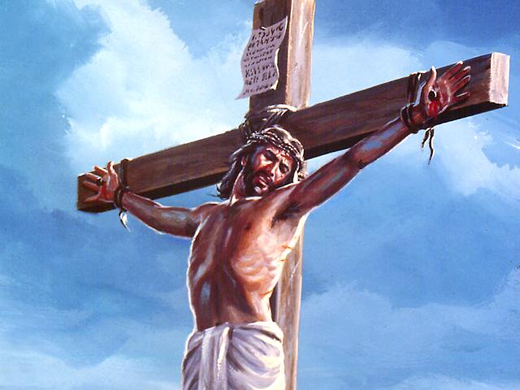
Rom 5:8 KJV But God commended his love toward us, in that, while we were yet sinners, Christ died for us.

Slide 25
And without controversy great is the mystery of godliness: God was manifest in the flesh, justified in the Spirit, seen of angels, preached unto the Gentiles, believed on in the world, received up into glory. 1Tim. 3:16

Slide 26
In the beginning was the Word, and the Word was with God, and the Word was God. John 1:1
And the Word was made flesh, and dwelt among us. John 1:14

Slide 27
Jesus is in the human family Heb. 2:11-14…
For both he that sanctifieth and they who are sanctified are all of one: for which cause he is not ashamed to call them brethren,
¹² Saying, I will declare thy name unto my brethren, in the midst of the church will I sing praise unto thee.
¹³ And again, I will put my trust in him. And again, Behold I and the children which God hath given me.
¹⁴ Forasmuch then as the children are partakers of flesh and blood, he also himself likewise took part of the same; that through death he might destroy him that had the power of death, that is, the devil; Hebrews 2:11-14

Slide 28
And I saw a new heaven and a new earth:for the first heaven and the first earth were passed away; and there was no more sea.2 And I John saw the holy city, new Jerusalem, coming down from God out of heaven, prepared as a bride adorned for her husband.3 And I heard a great voice out of heaven saying, Behold, the tabernacle of God is with men, and he will dwell with them, and they shall be his people, and God himself shall be with them, and be their God… Rev. 21:1-3

Slide 29
4 And God shall wipe away all tears from their eyes; and there shall be no more death, neither sorrow, nor crying, neither shall there be any more pain: for the former things are passed away. 5 And he that sat upon the throne said, Behold, I make all things new. And he said unto me, Write: for these words are true and faithful. Rev. 21:4-7

Slide 30
As we contemplate what Christ did on the cross, many ask the question:
But how can Jesus’ death preserve us from future sin and its consequences?

Slide 31
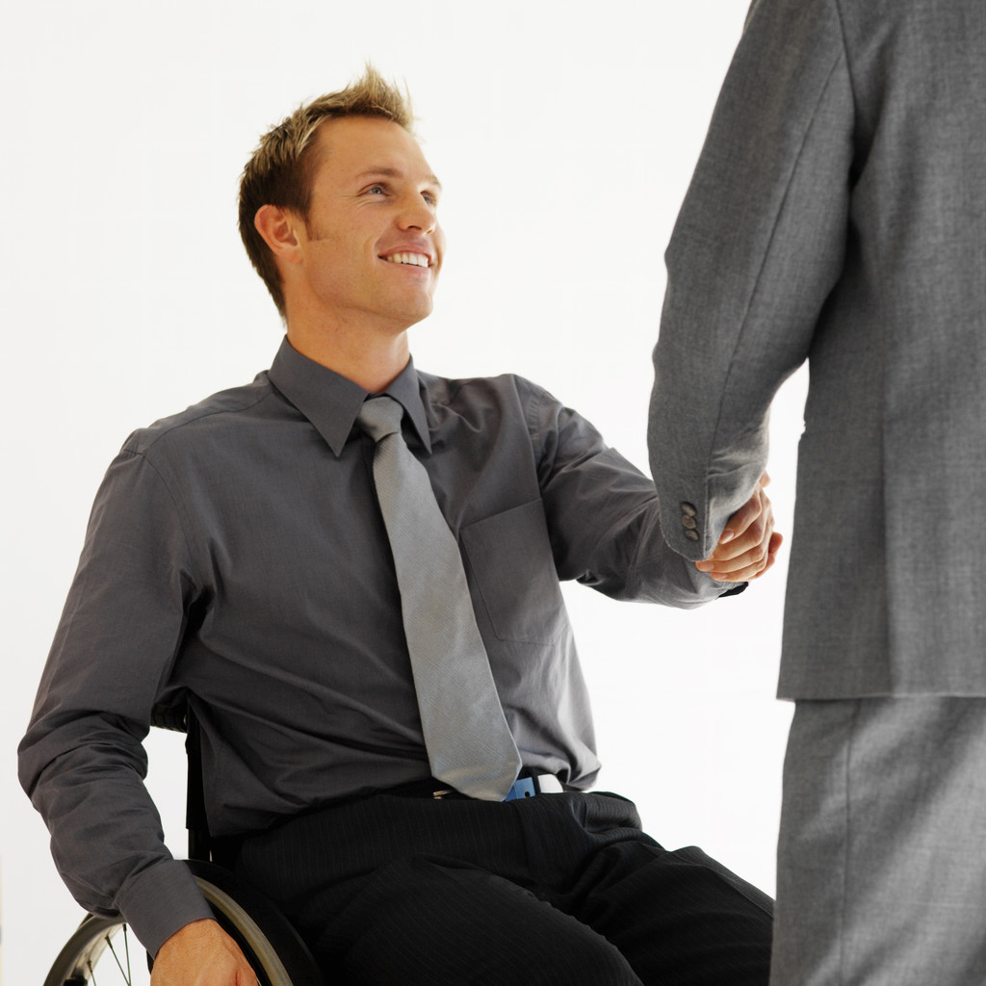
Story:
Johnny’s debt…

Slide 32
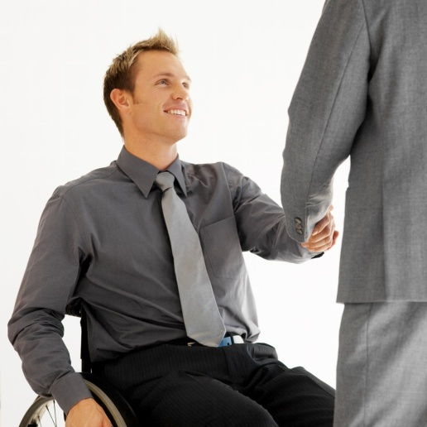
Johnny borrowed half a million dollars from the bank for a business venture. At first business went well; but
one day tragedy struck and Johnny lost everything.

Slide 33

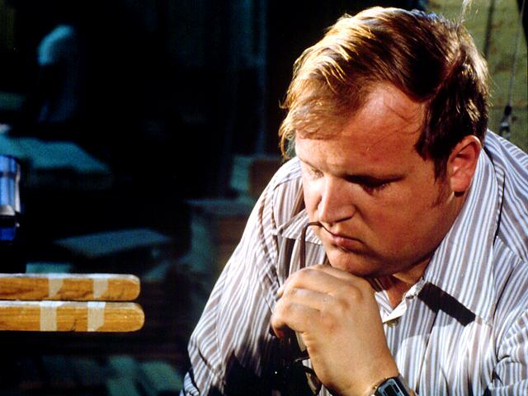
Soon the bank called Johnny in and requested then later demanded its money; when Johnny
pled bankruptcy the bank threatened to send in the receivers to confiscate everything of value that Johnny owned. Johnny was confused and horrified.

Slide 34

As Johnny was about to leave the bank confused and worried, the manager turned and told him that he
would cancel the debt, loan him more money; and would himself stand guarantor that Johnny
never fell into debt again!

Slide 35
This, friends, is how Jesus takes care of our future sins…Listen to the Bible:
Isa. 41:10 Fear thou not; for I am with you: be not dismayed; for I am your God: I will strengthen you; yea, I will help you; yea, I will uphold you with the right hand of my righteousness.

Slide 36
Isa. 41:13 For I the LORD your God will hold your right hand, saying unto you, Fear not; I will help you.
Deut. 31:6 Be strong and of a good courage, fear not, nor be afraid of them: for the LORD your God, he it is that goes with you; he will not fail you, nor forsake you.
Now here is how it actually works:

Slide 37
1. From birth to conversion the sacrifice of Jesus pardons all your past sins.
Repent therefore, and be converted, that your sins may be blotted out… Acts 3:19
I have blotted out, as a thick cloud, your transgressions, and, as a cloud, your sins… Isa. 44:22

Slide 38
2. Now from conversion to the grave God promises to keep you saved. Here again the Word of God:
There is therefore now no condemnation to them which are in Christ Jesus, who walk not after the flesh, but after the Spirit. Rom. 8:1
Looking unto Jesus the author and
finisher of our faith… Heb. 12:2

Slide 39
BUT WE ALL WITH OPEN FACE, BEHOLDING AS IN A GLASS THE GLORY OF THE LORD, ARE CHANGED INTO THE SAME IMAGE, FROM GLORY TO GLORY, EVEN AS BY THE SPIRIT OF THE LORD. 2 COR 3:18
HOW BE IT, WHEN HE THE SPIRIT OF TRUTH IS COME HE WILL GUIDE YOU INTO ALL TRUTH. JOHN 16:13.

Slide 40

How should we respond to this act of mercy, friends?
Here is God’s appeal to us:
Repent therefore, and be converted, that your sins may be blotted out… Acts 3:19
What is conversion? Conversion is accepting Jesus’ sacrifice for us; and it is characterised by repentance and baptism.
Listen to this text from the book of Acts:

Slide 41
Now when they heard this, they were pricked in their heart, and said unto Peter and to the rest of the apostles, Men and brethren, what shall we do?
Then Peter said unto them, Repent, and be baptized every one of you in the name of Jesus Christ for the remission of sins, and ye shall receive the gift of the Holy Ghost. Acts 2:37, 38
But there is something else we need that God gives us freely…

Slide 42
We must have faith. The Bible tells us:
But without faith it is impossible to please him: for he that comes to God must believe that he is, and that he is a rewarder of them that diligently seek him. Heb. 11:6
What is faith? Faith is belief and trust. Not belief alone, but both belief and trust. Notice the text above again, it says we must believe…We also read in the Psalms:
You that fear the LORD, trust in the LORD: Ps. 115:11. You cannot trust without belief...

Slide 43
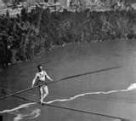
Let me illustrate with a story: The tightrope walker. Jean F. Gravelet; 1859…
Charles
Blonden

Slide 44
In 1859 Charles Blonden became the most famous individual to walk across the Niagara Falls. He skipped across; pushed a wheel barrow across and
even cooked an omelette in the wheel barrow and eat it up there.
When he returned he asked the cheering crowd if they thought he could

Slide 45
do it again? They all said yes, yes. Then he asked them if they thought he could do it with someone in the
Wheelbarrow? Again they cried yes, yes! At this point he called for a volunteer to come up and get into the barrow. No one volunteered to put his or her life in his hands!

Slide 46
You see, friends, they all believed that he could do it. But they did not have faith to believe that they could
trust their lives in his care, although he proved himself well able.
So it is, friends, with faith and belief in Jesus’ sacrifice…

Slide 47
Faith, then, is believing and trusting God with your life. Your choice to exercise faith determines your destiny..
The gospel then, shows us five things:
Sin against God is rebellion against him; and this brings death; and all have sinned.
God’s merciful response to our death sentence is to come in Jesus Christ and die for us.

Slide 48
God’s merciful and loving act of keeping us saved as we live in Him until our death.
God’s preservation of law and order through out the universe by not destroying His law in order to forgive us, but by paying the penalty Himself in Jesus.
God calls upon everyone to make a decision for Him and live.

Slide 49

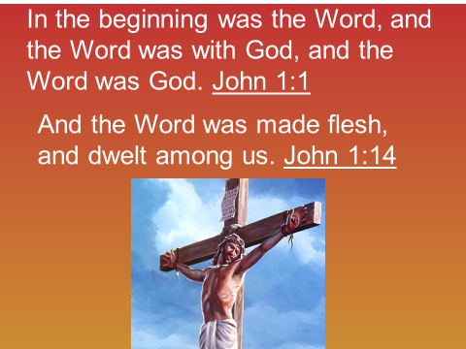
This, friends, is the gospel of Jesus Christ for mankind.
Here is God’s appeal to you:
(Isa 55:3 KJV) Incline your ear, and come unto me: hear, and your soul shall live; and I will make an everlasting covenant with you…Today, if you will hear his voice, then harden not your hearts. Tomorrow can be too late.

Slide 50
Was this gospel presentation clear to you?
Is there anything that you did not understand?
Are you willing to accept Jesus always into your life today?
Are you willing to continue walking with Him until He comes back to this earth for His people?

Slide 51
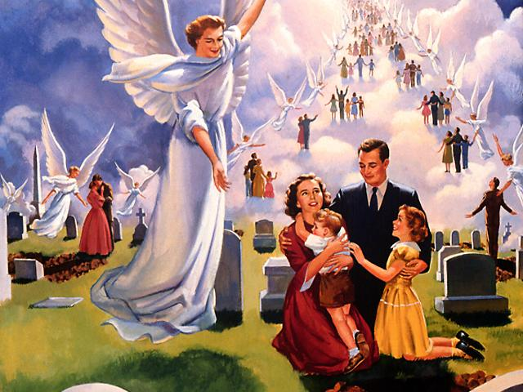
Be
Ready!

